Slide 1


SharePoint Saturday 2017: SharePoint PnP PowerShell and what it can do for my SharePoint Environment
Presented by Peter Allen

Slide 2

Meeting Agenda
Who am I?
SharePoint PnP PowerShell Overview
SharePoint PnP PowerShell Setup
SharePoint PnP PowerShell Live Examples

Slide 3

Who am I?

Slide 4
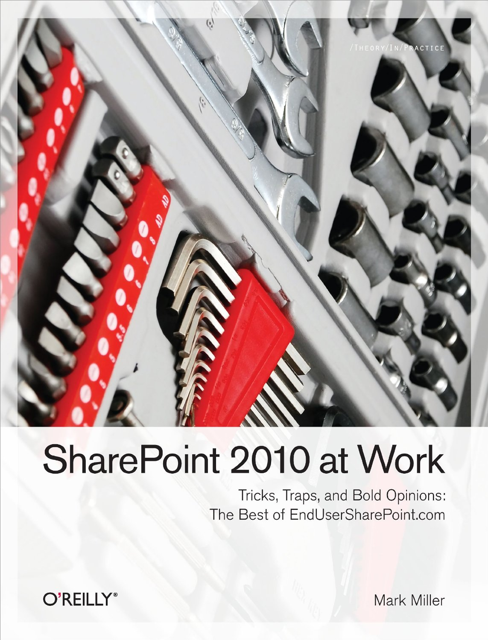
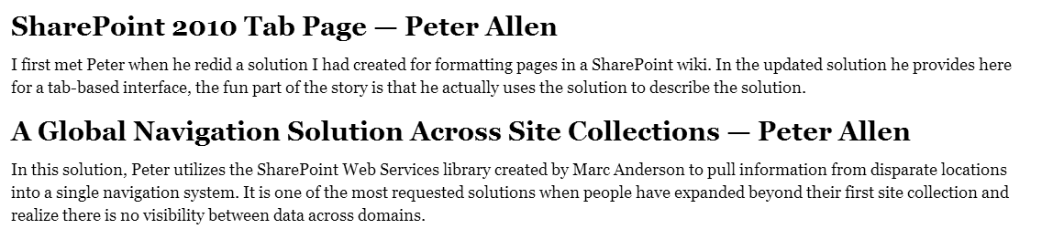
Who am I?
Name: Peter Allen
Location: Sacramento
Experience: Working with SharePoint for over 12 years from 2003 to 2016 / Office 365
Written Chapters for:
SharePoint 2010 at Work: Tricks, Traps, and Bold Opinions

Slide 5



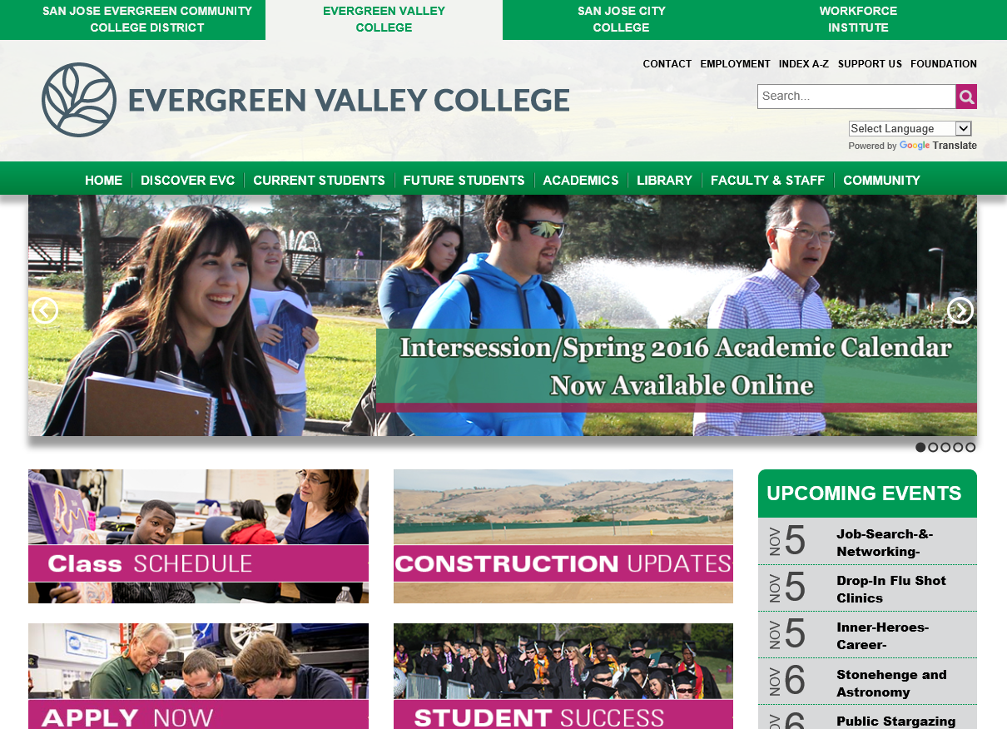
Public Web Sites – SP 2013

Slide 6
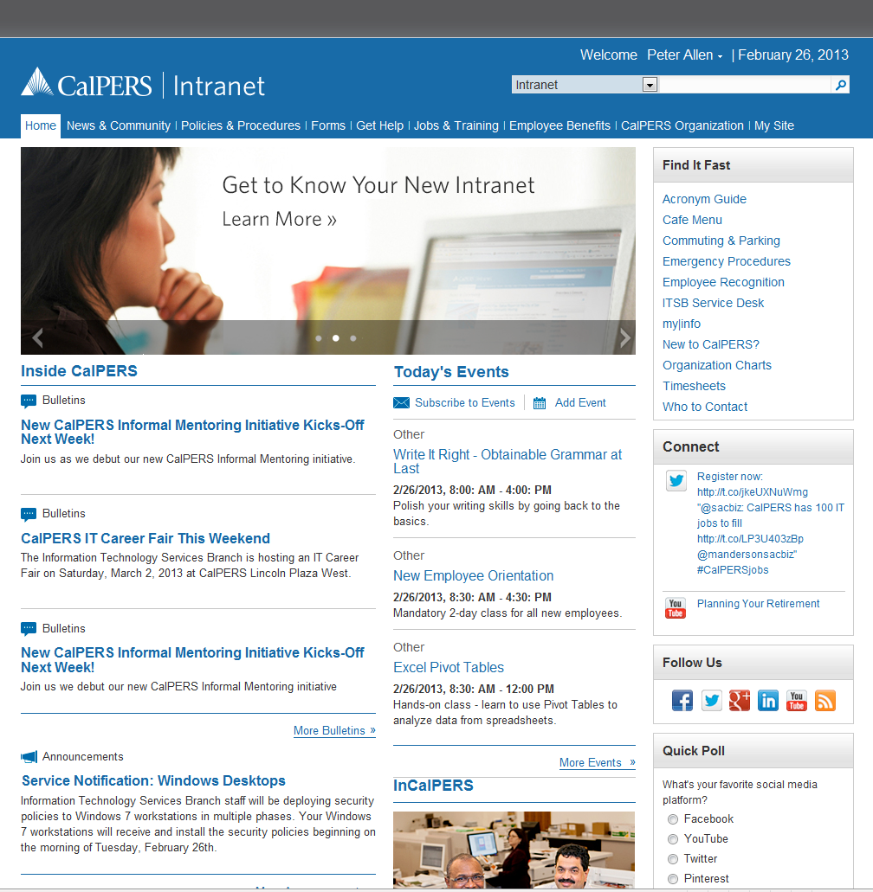
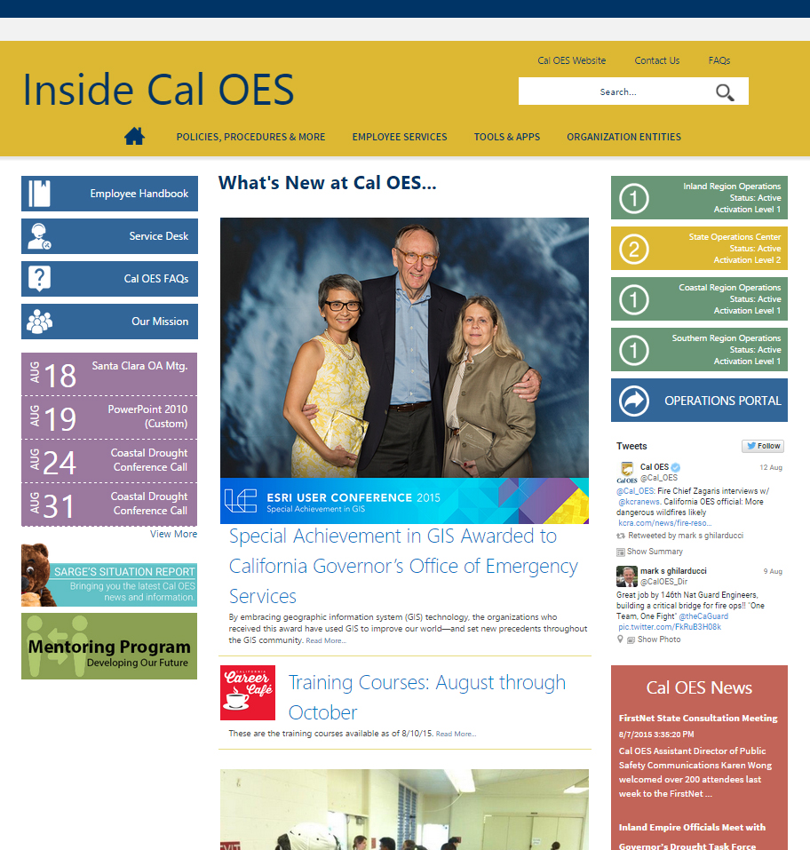
Intranets - SP 2010 / 2013 / O365

Slide 7
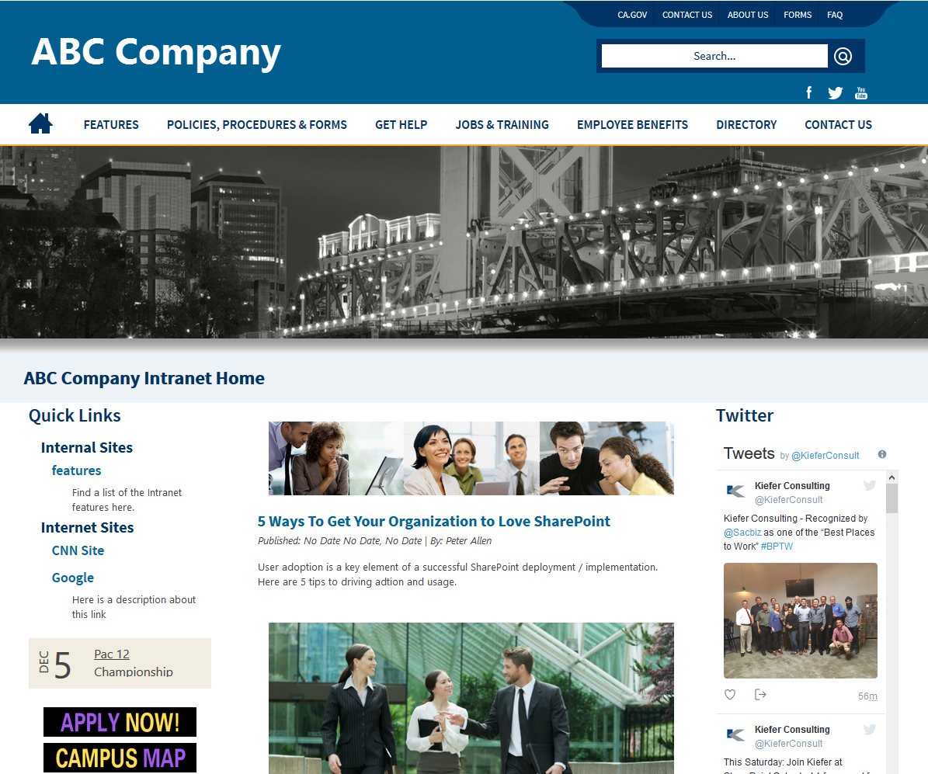
Site Deployed with SharePoint PnP PowerShell

Slide 8
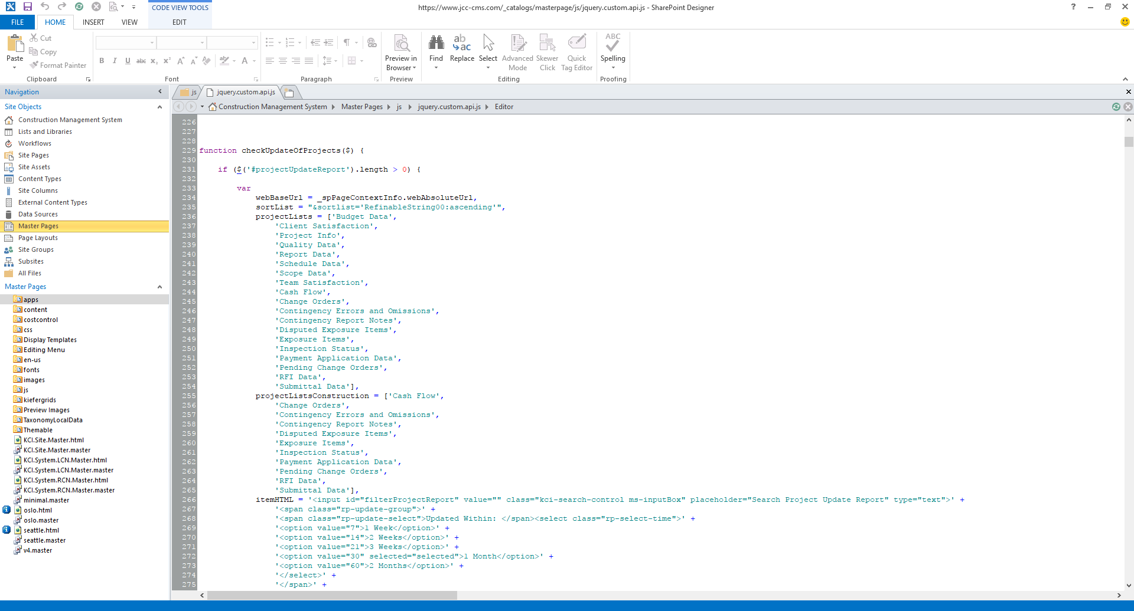
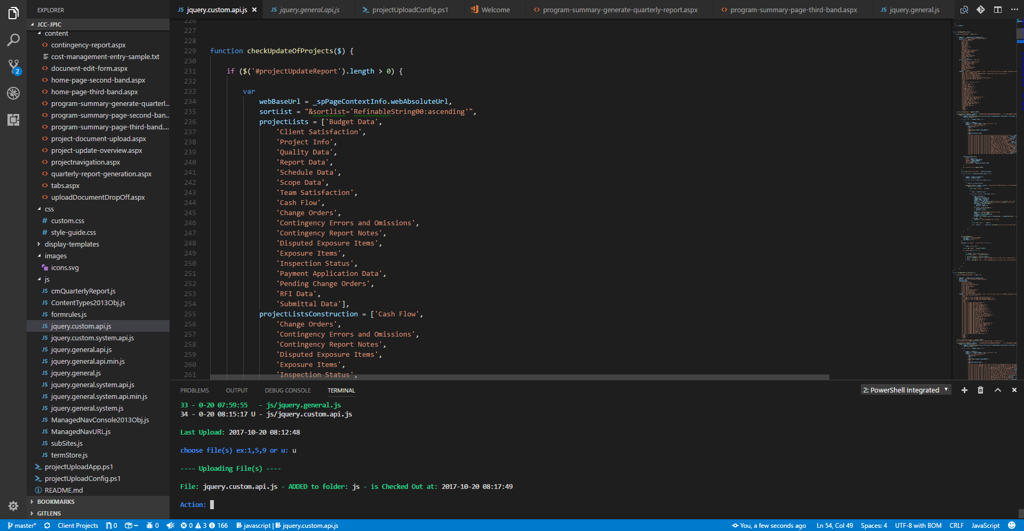
SharePoint Coding with Visual Studio Code
What if you could use SharePoint PnP PowerShell with Visual Studio Code yo update Master Pages, Page Layouts, JavaScript, CSS, and other files?

Slide 9

What is SharePoint PnP PowerShell?

Slide 10
What is SharePoint PnP PowerShell
PowerShell
is a task automation and configuration management framework from Microsoft, consisting of a command-line shell and associated scripting language built on the .NET Framework and .NET Core.
SharePoint PnP PowerShell
contains a library of PowerShell commands (PnP PowerShell) that allows you to perform complex provisioning and artifact management actions towards SharePoint.
PnP
Patterns and Practices

Slide 11
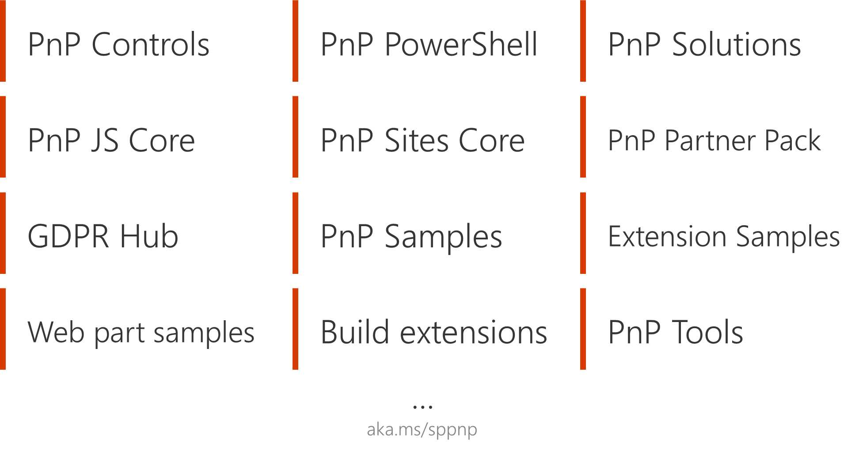
PnP Possibilities

Slide 12
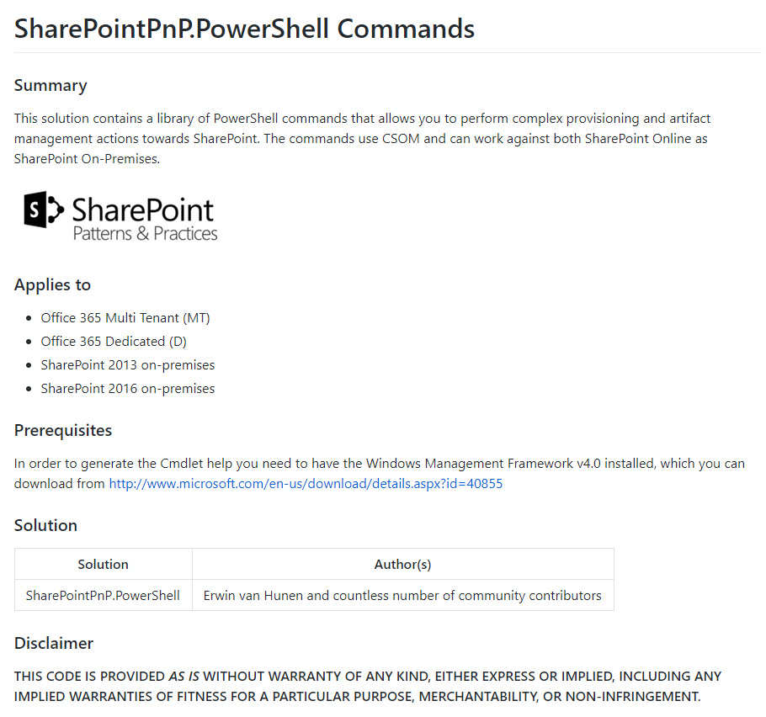
https://github.com/SharePoint/PnP-PowerShell

Slide 13
SharePoint PnP PowerShell Categories
Apps
Base Cmdlets
Branding
Client-Side Pages
Content Types
Document Sets
Event Receivers
Features
Fields
Files and Folders
Information Management
Lists
Microsoft Graph
Provisioning
Publishing
Records Management
Search
SharePoint Recycle Bin
SharePoint WebHooks
Sites
Taxonomy
Tenant Administration
User and group management
User Profiles
Utilities
Web Parts
Webs
Workflows

Slide 14
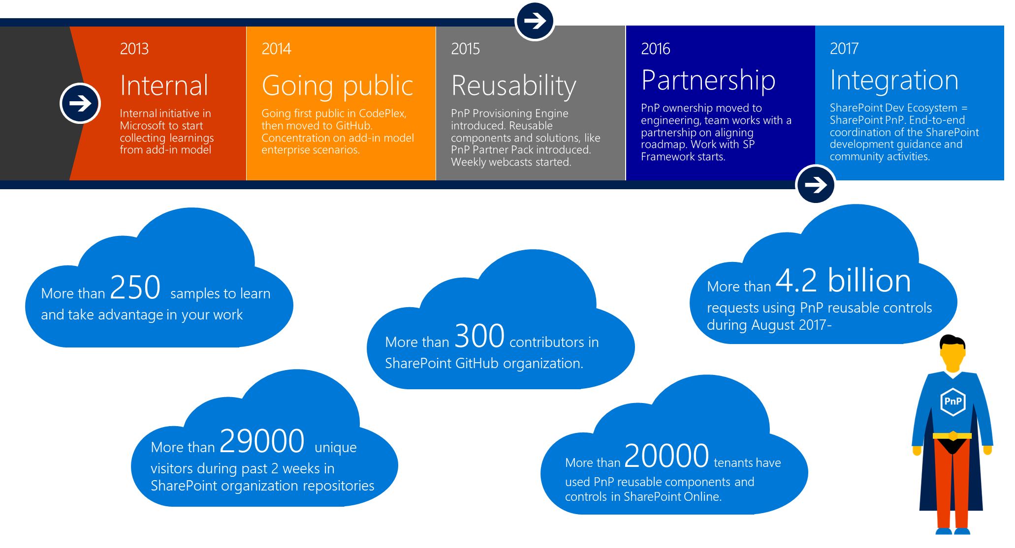
PnP History

Slide 15

SharePoint PnP PowerShell Setup

Slide 16
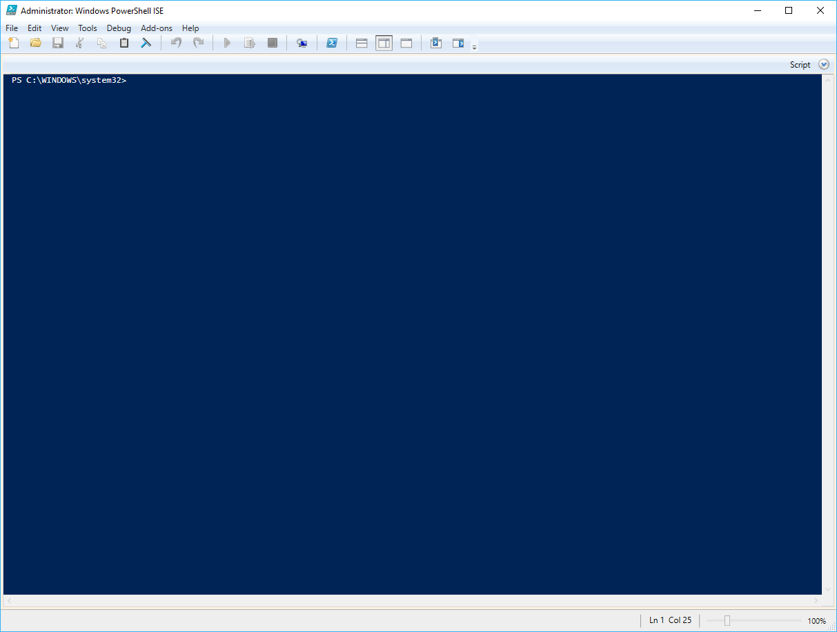
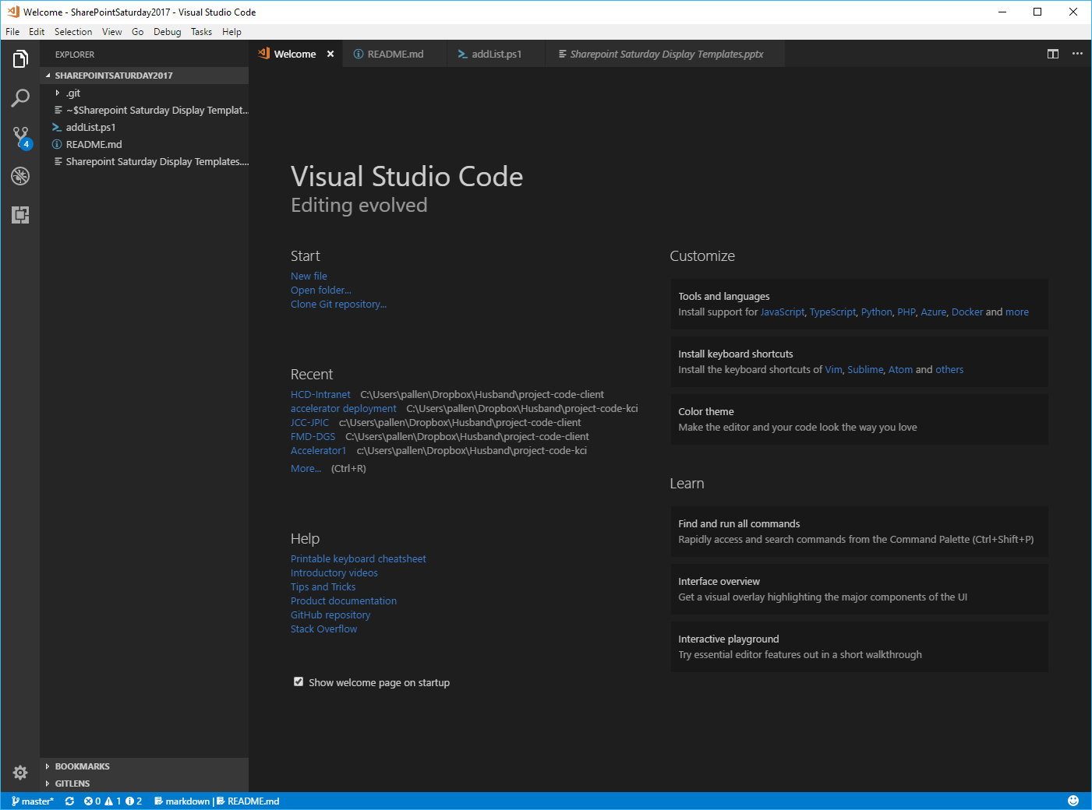
PowerShell Tools
Two Tools for using PowerShell
Windows PowerShell ISE
Comes with Windows 10
Visual Studio Code
Must add extension: Visual Studio Team Services

Slide 17
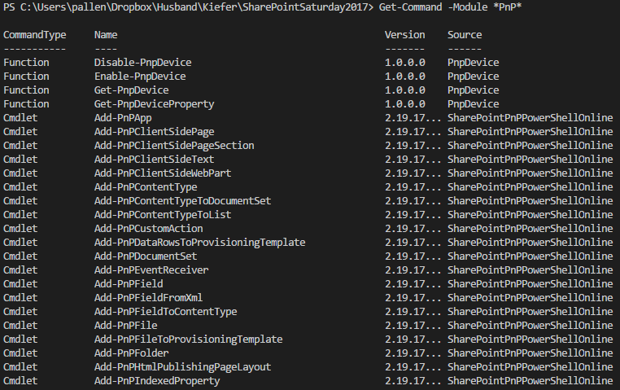
Check the Version
Check what is installed
Command:
Get-Command -Module *PnP*

Slide 18
SharePoint PowerShell PnP
SharePoint Online
Install-Module SharePointPnPPowerShellOnline
Uninstall-Module SharePointPnPPowerShellOnline
SharePoint 2016
Install-Module SharePointPnPPowerShell2016
Uninstall-Module SharePointPnPPowerShell2016
SharePoint 2013
Install-Module SharePointPnPPowerShell2013
Uninstall-Module SharePointPnPPowerShell2013

Slide 19
SharePoint PnP PowerShell Live Examples
One Line Commands

Slide 20
Setup
Setup our environment:
First check to see what version of SharePoint PnP PowerShell is installed
Command:
Get-Command -Module *PnP*
Next Install, Uninstall / Install or do nothing for SharePoint PnP PowerShell
Commands
SharePoint Online
Install-Module SharePointPnPPowerShellOnline
Uninstall-Module SharePointPnPPowerShellOnline
SharePoint 2016
Install-Module SharePointPnPPowerShell2016
Uninstall-Module SharePointPnPPowerShell2016
SharePoint 2013
Install-Module SharePointPnPPowerShell2013
Uninstall-Module SharePointPnPPowerShell2013
For Visual Studio Code
Install extension
Visual Studio Team Services

Slide 21
Connect
First things first
You must connect to the SharePoint site before you can do anything.
Command:
Connect-PnPOnline –Url
-Url is the URL for the site you want to connect to
Example
Connect-PnPOnline –Url https://kieferconsultinginc.sharepoint.com/sites/SharePointSaturday2017/

Slide 22
Our First Command
Let’s create a list, simple
Command:
New-PnPList -Title "First Demo List" -Url "FirstDemoList" -Template Announcements

Slide 23
Let’s Add More
Change List Settings
Command:
Set-PnPList -Identity "First Demo List" -EnableVersioning $true -MajorVersions 20
Add List Item
Command
Add-PnPListItem -List "First Demo List" -ContentType "Item" -Values @{"Title" = "Test Title 1"; "Body" = "Here is content for the body"}

Slide 24
Add to Quick Launch Navigation
Command:
Add-PnPNavigationNode -Title "First Demo List" -Url "https://kieferconsultinginc.sharepoint.com/sites/SharePointSaturday2017/FirstDemoList/" -Location "QuickLaunch"
Add a View to List
Command:
Add-PnPView -List "First Demo List" -Title "First Demo List Items" -Fields "Title","Body"

Slide 25
SharePoint PnP PowerShell Live Examples
PowerShell File – Add Lists to Multiple Sites

Slide 26
Add Lists to Multiple Sites
In this example we are going to use the power of PowerShell scripting to do the following:
Add the following to multiple sites
Add three different Lists
Add a View to each List
Update each List Setting
Update Version settings
Add New-Home-Page
And make it the default homepage

Slide 27
Multiple Sites - Connect
Variables
$spAddSites = @(
@{
Site = "https://kieferconsultinginc.sharepoint.com/sites/SharePointSaturday2017/SampleA/"
}
@{
site = "https://kieferconsultinginc.sharepoint.com/sites/SharePointSaturday2017/SampleB/"
}
)
Script
foreach ($spSite in $spAddSites) {
Connect-PnPOnline $spSite.site -Credentials $Credentials
}

Slide 28
Multiple Sites – Add Lists
Variables
$spAddLists = @(
@{
Title = "Demo List"
URL = "DemoList"
Template = "Announcements"
}
@{
Title = "Demo Contacts"
URL = "DemoContacts"
Template = "Contacts"
}
@{
Title = "Demo Custom"
URL = "DemoCustom"
Template = "GenericList"
}
)
Script
foreach ($spList in $spAddLists) {
$listTitle = $spList.Title
$listUrl = $spList.Url
$listTemplate = $spList.Template
$newList = New-PnPList -Title "$listTitle" -Url "$listUrl" -Template $listTemplate -EnableVersioning –OnQuickLaunch
Write-Host -ForegroundColor White "LIST: " -nonewline;
Write-Host -ForegroundColor Green $listTitle -nonewline;
Write-Host -ForegroundColor White " - ADDED"
}

Slide 29
Multiple Sites – Add List View
Variables
$spAddViews = @(
@{
ListTitle = "Demo List"
ViewTitle = "New View"
ViewFields = "Title,Body"
ViewQuery = '<OrderBy><FieldRef Name="Title" /></OrderBy>'
DefaultView = ""
}
@{
ListTitle = "Demo Contacts"
ViewTitle = "New View"
ViewFields = "Edit,LinkTitle,FirstName,JobTitle,CellPhone,WorkPhone,Email"
ViewQuery = '<OrderBy><FieldRef Name="Title" /></OrderBy>'
DefaultView = "yes"
}
@{
ListTitle = "Demo Custom"
ViewTitle = "New View"
ViewFields = "Title"
ViewQuery = '<OrderBy><FieldRef Name="Title" /></OrderBy>'
DefaultView = "yes"
}
)
Script
foreach ($spViewsAdd in $spAddViews) {
$listTitle = $spViewsAdd.ListTitle
$viewTitle = $spViewsAdd.ViewTitle
$viewFields = $spViewsAdd.ViewFields -split (',')
$viewQuery = $spViewsAdd.ViewQuery
$viewDefaultView = $spViewsAdd.DefaultView
Remove-PnPView -List "$listTitle" -Identity "$viewTitle" -Force
If ( $viewDefaultView -eq 'yes') {
Add-PnPView -List $listTitle -Title "$viewTitle" -Fields $viewFields -Query "$viewQuery" -SetAsDefault
}
else {
Add-PnPView -List $listTitle -Title "$viewTitle" -Fields $viewFields -Query "$viewQuery"
}
Write-Host -ForegroundColor White "LIST: " -nonewline;
Write-Host -ForegroundColor Green $listTitle -nonewline;
Write-Host -ForegroundColor White " - VIEW ADDED: " -nonewline;
Write-Host -ForegroundColor Green $viewTitle
}

Slide 30
Multiple Sites – Update List Settings
Variables
$spListSettingsUpdate = @(
@{
ListTitle = "Demo List"
MajorVersions = 30
}
@{
ListTitle = "Demo Contacts"
MajorVersions = 20
}
@{
ListTitle = "Demo Custom"
MajorVersions = 10
}
)
Script
foreach ($spListSettings in $spListSettingsUpdate) {
$listTitle = $spListSettings.ListTitle
$listMajorVersions = $spListSettings.MajorVersions
Set-PnPList -Identity $listTitle -EnableVersioning $true -MajorVersions $listMajorVersions
Write-Host -ForegroundColor White "LIST SETTINGS: " -nonewline;
Write-Host -ForegroundColor Green $listTitle -nonewline;
Write-Host -ForegroundColor White " - UPDATED"
}

Slide 31
Multiple Sites – Add New Page
Variables
$spNewHomePage = @(
@{
pageName = "New-Home-Page"
}
)
Script
foreach ($spNewHomePageItem in $spNewHomePage) {
$homePageName = $spNewHomePageItem.pageName
Add-PnPClientSidePage -Name $homePageName
Set-PnPHomePage -RootFolderRelativeUrl SitePages/$homePageName.aspx
Write-Host -ForegroundColor White "HOME PAGE: " -nonewline;
Write-Host -ForegroundColor Green $homePageName -nonewline;
Write-Host -ForegroundColor White " - ADDED"
}

Slide 32


Questions & Answers

Slide 33
Get the Presentation and Code Examples
http://github.com/kcipha

Slide 34
Thank You

